Slide 1
PHP (1)
Lecture 23

Slide 2
What is PHP
PHP is an acronym for "PHP: Hypertext Preprocessor"
PHP is a widely-used, open source scripting language
PHP scripts are executed on the server
PHP files can contain text, HTML, CSS, JavaScript, and PHP code
PHP code is executed on the server, and the result is returned to the browser as plain HTML
PHP files have extension “.php”
PHP runs on various platforms (Windows, Linux, Unix, Mac OS X, etc.)
PHP is compatible with almost all servers used today.
PHP supports a wide range of databases.
Used to create dynamic web pages

Slide 3
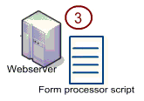

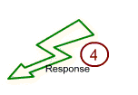
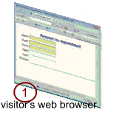

Slide 4
Setting the Environment
A web server (Xamp)
https://www.apachefriends.org/download.html
PHP
MySql
Editor
Macromedia Dreamweaver /Adobe Dreamweaver / Notepad++

Slide 5
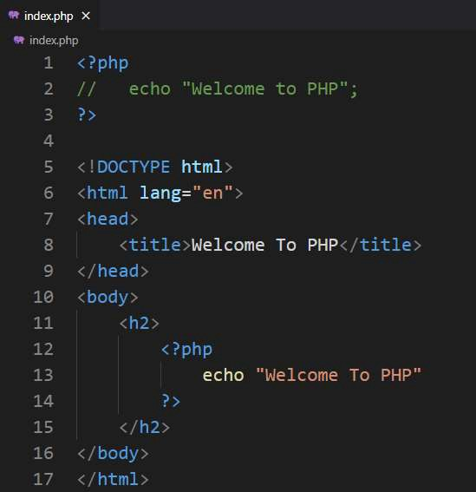
How php fits in HTML file
Embedding PHP in HTML code
HTML can also be written inside the PHP code
PHP can also be written as a standalone program with no HTML at all

Slide 6
PHP Syntax
6
PHP code is denoted in the page with opening and closing tags, as follows:
<?php and ?>
<? or ?>
<script language=“PHP”>…… </script>
PHP statements end with a semicolon
Comments can be added as
// for one line comment
/* and */ for multiple lines comment

Slide 7
Writing and Executing PHP code
Open a notepad
Write PHP code
Save file with .php extension
Save all the files in one directory
Copy this directory in
C:\wamp\www\
C:\Xamp\htdocs\

Slide 8
Writing and Executing PHP code
Start WAMP/XAMP server
Go to localhost either by typing localhost in address bar of the browser or by clicking the WAMP sever icon in the toolbar and selecting localhost
Select your web directory from the list of project on the WAMP/ XAMP server home page
Select the file to execute

Slide 9
Writing output to the browser
echo(): is used to write output on the browser
echo(“Welcome to PHP”);
echo “Welcome to PHP”;
print(): can also be used to write out put on the browser
print(“Welcome to PHP”);
print “Welcome to PHP”;
printf(): can also be used for writing output

Slide 10
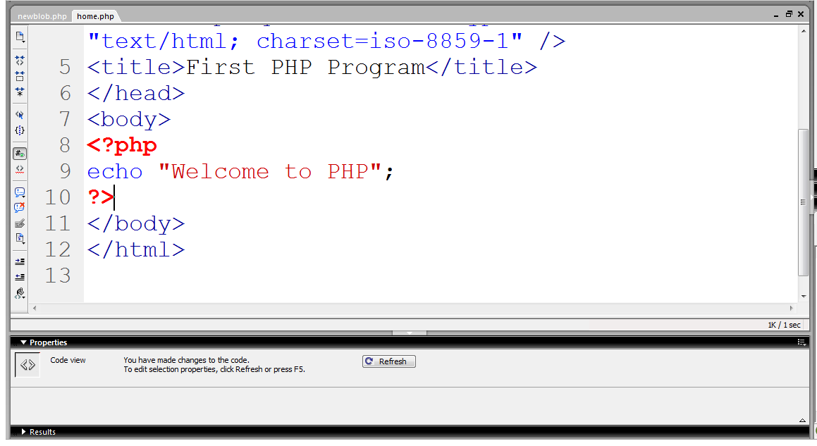
First PHP program
PHP block starts
Writing on browser
Ending PHP block

Slide 11
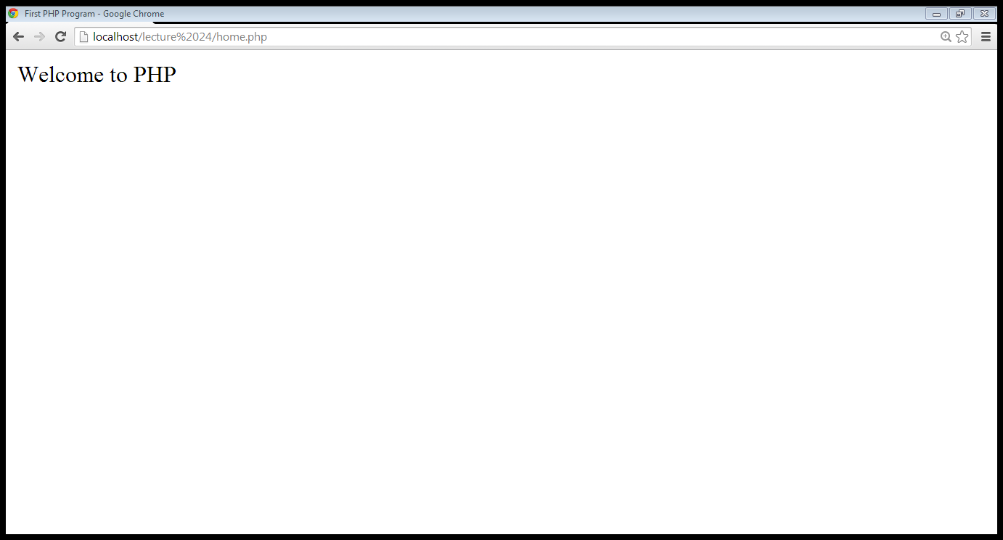
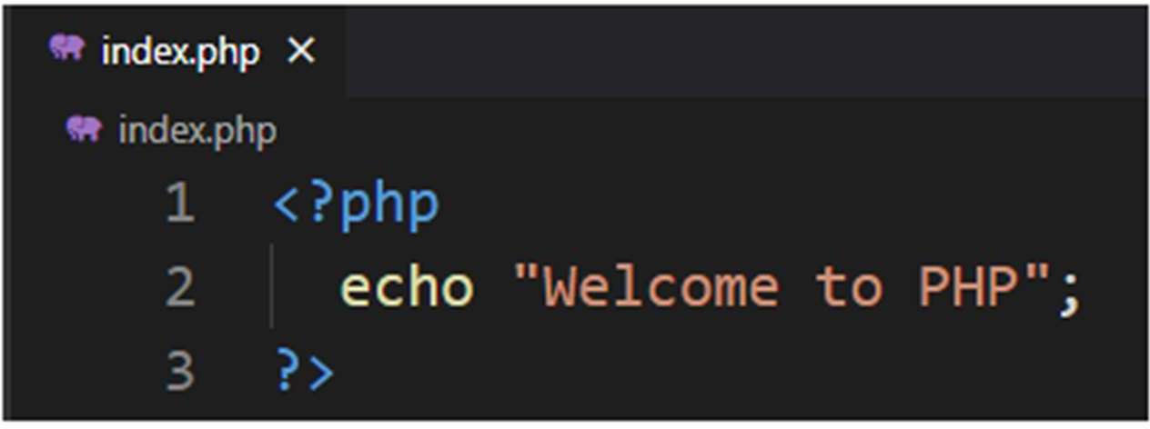
Out put from the PHP code

Slide 12
Integrating HTML with PHP
echo statement outputs whatever it’s told to the browser
It can output not only plain text but also HTML tags
echo “<h1> Welcome to the PHP</h1>”;

Slide 13
Integrating HTML with PHP
Using quotation marks:
echo “<h1 style=“color:red”> Welcome to PHP</h1>”;
echo “<h1 style=‘color:red’> Welcome to PHP</h1>”;
echo “<h1 style=\“color:red\”> Welcome to PHP</h1>”;

Slide 14
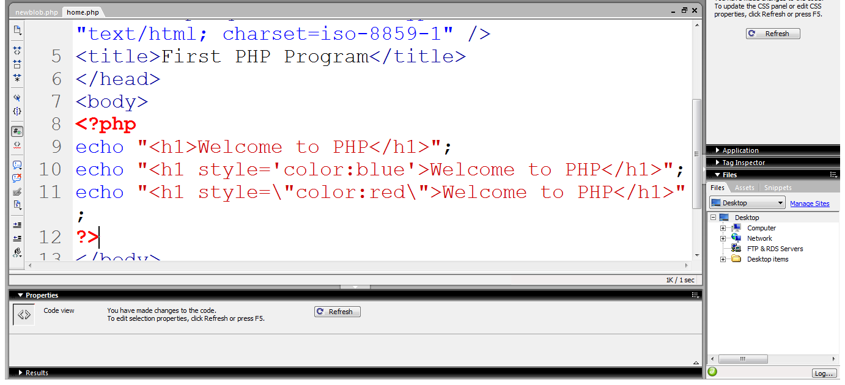
Using heading
Arranging quotations
Using escape character

Slide 15
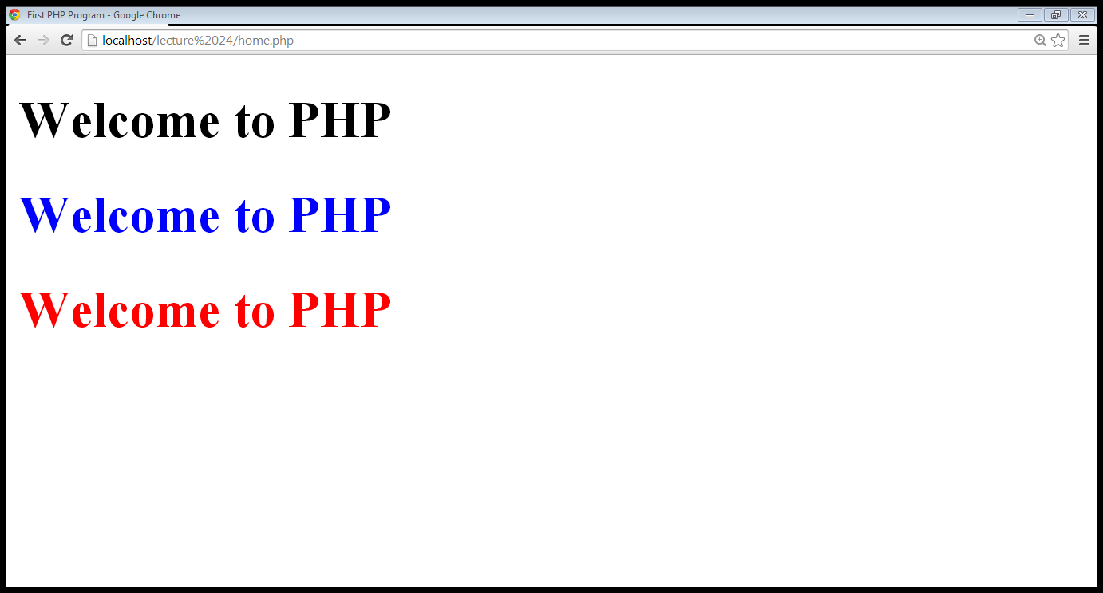

Slide 16
Constant
A constant is a placeholder for a value that you reference within your code that is formally defined before using it
must begin with a letter or an underscore
are case sensitive
typically they are named using all capital letters
PHP function define() is used to assign a value to a constant

Slide 17
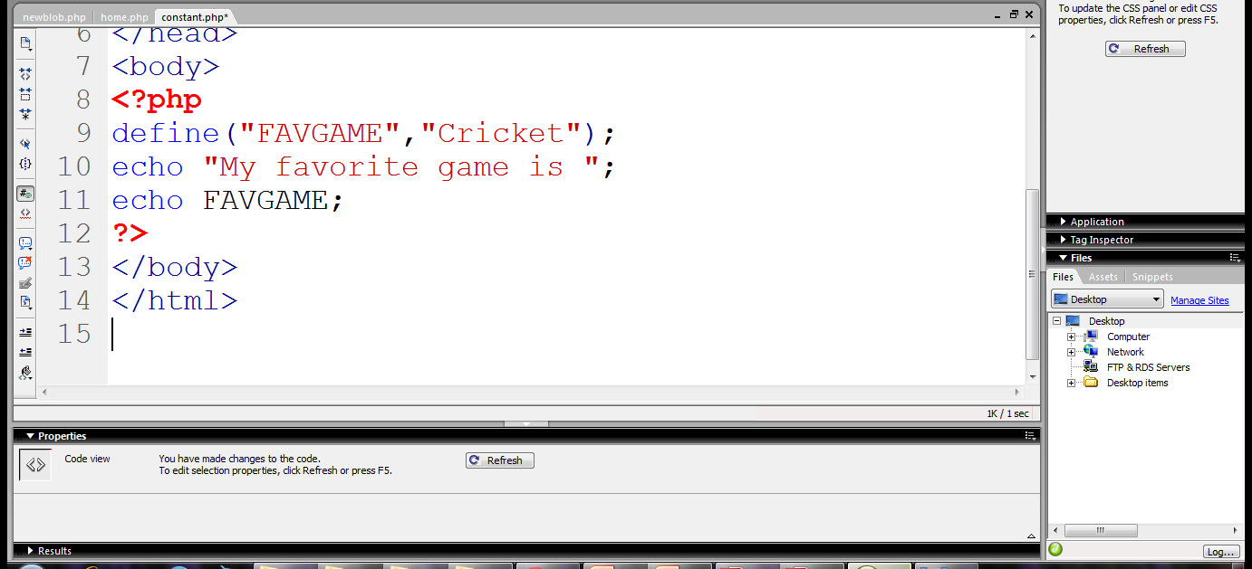
Constant name
Value of constant
Displaying the value

Slide 18
Variables
Begin with $ sign
First character must be a letter or underscore
Remaining characters may be letters, numbers or underscores
Don’t need to declare or initialize
Case sensitive
Data types does not require to be declare explicitly
Supports
Float, integer, boolean, string, array, object

Slide 19

Variable declared
Initial value
Displaying variable’s value

Slide 20
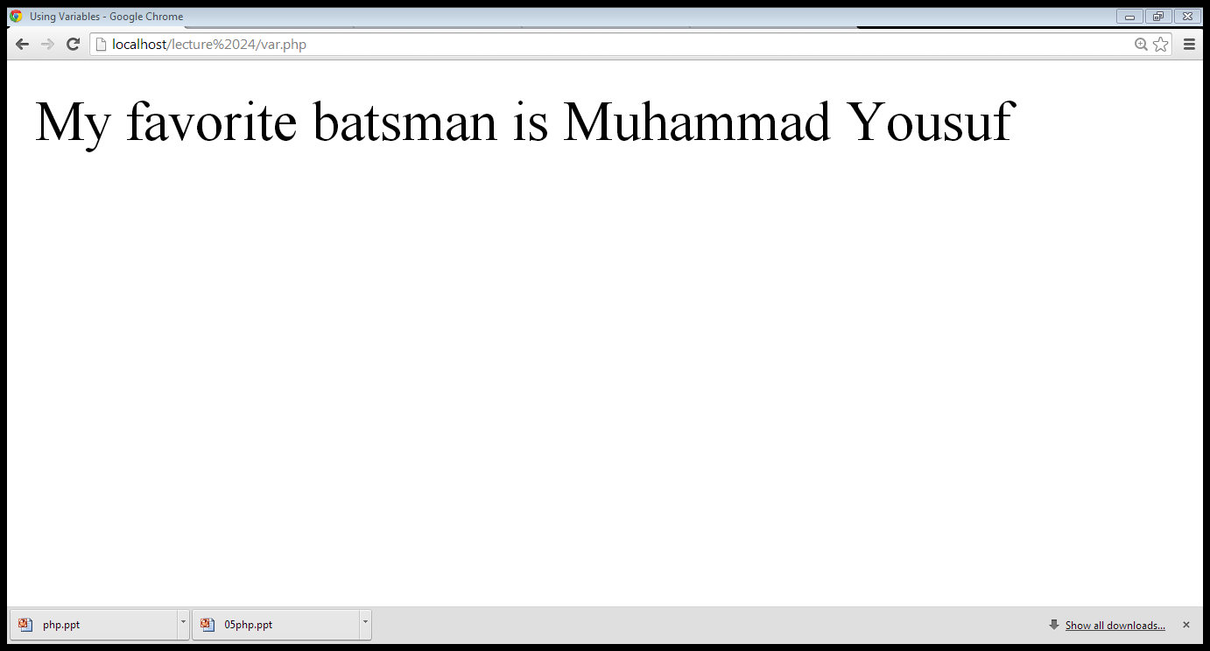
OutPut

Slide 21
Variables
The gettype() function returns the type of the provided variable
The settype() function converts a variable to the type specified by type

Slide 22
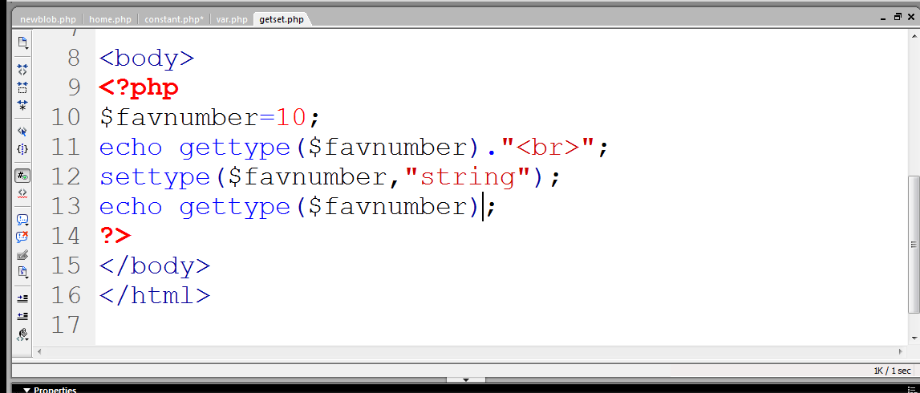
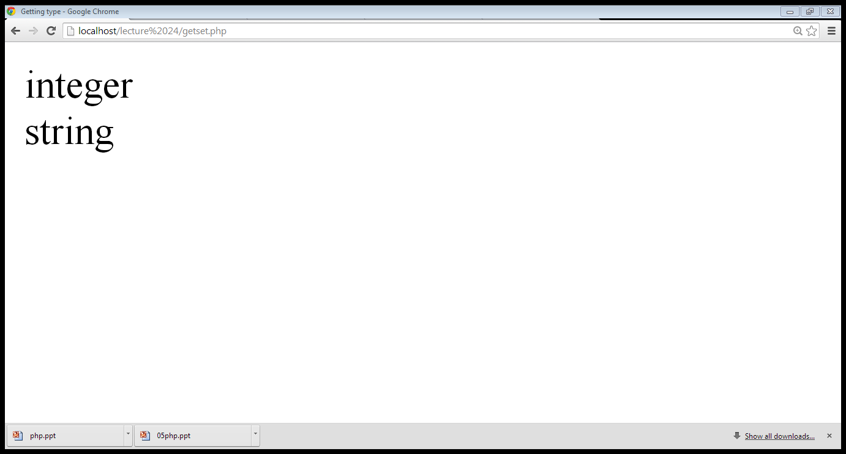

Slide 23
Type Determination
A number of functions are available for determining a variable’s type
boolean is_name(mixed var)
is_array()
is_bool()
is_float()
is_integer()
is_null()
is_numeric()
is_string()

Slide 24
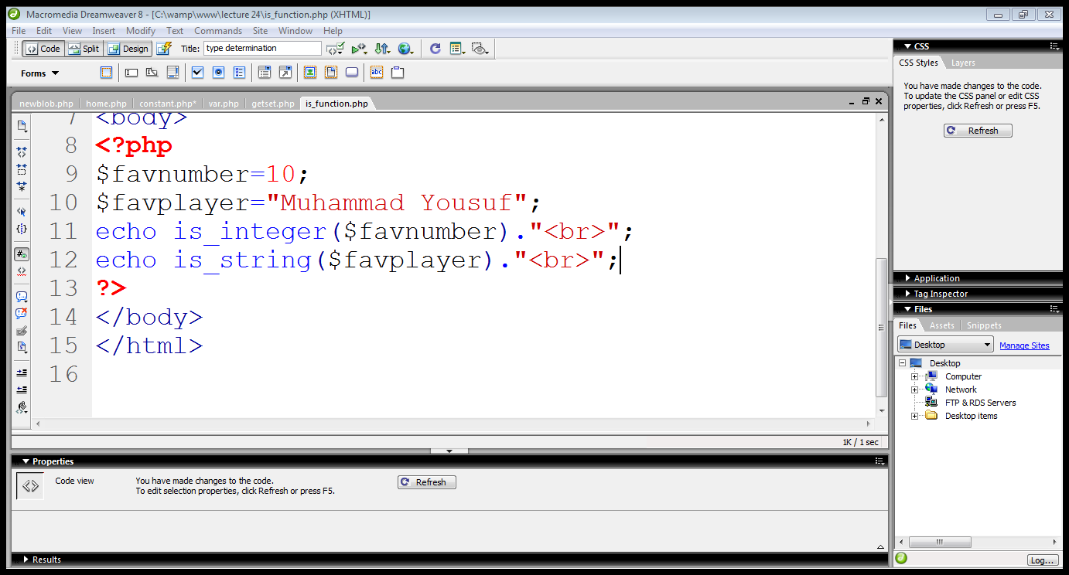
Type determination…

Slide 25
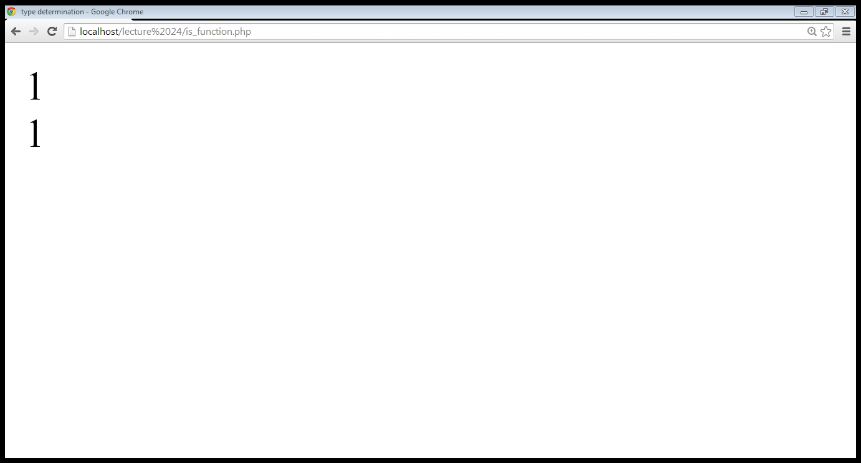
Type determination…

Slide 26
Arithmetic Operations
Arithmetic Operators:
+, - ,*, /, %
Assignment Operators:
=
+= ($a +=$b ), *= , /=
.= ($a .= $b)

Slide 27
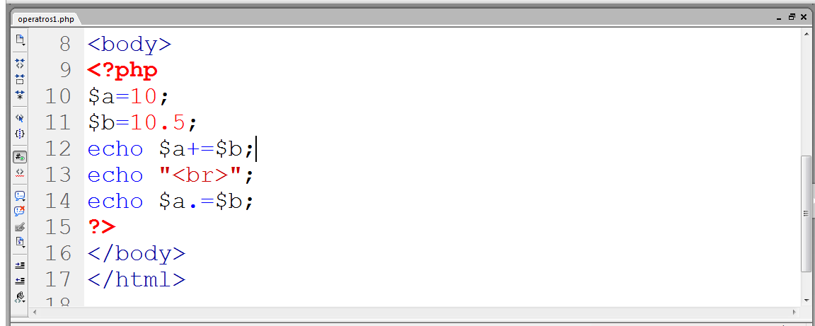
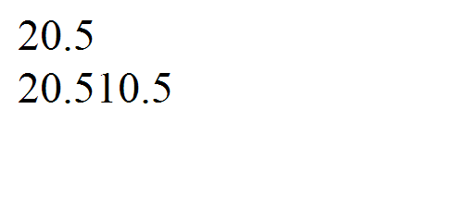
Arithmetic Operations / Operators
Adds $b in $a
Output
Concatenates $b with $a

Slide 28
Assignment Operators
String Operators:
. , .=
$a=“abcd”.”efgh”; $a=abcdefgh
$a.=“ijk”; $a=abcdefghijk
Increment/decrement Operators:
++,--
$b=$a++
$b=++$a

Slide 29
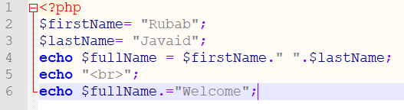

First variable
Second variable
Concatenation
Using .=
Output

Slide 30
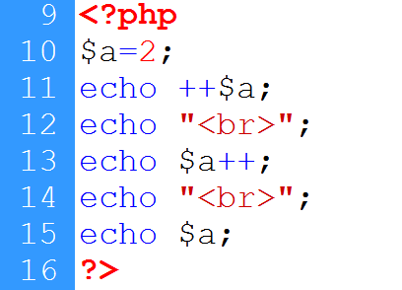
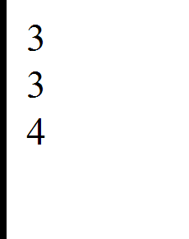
Variable declared
Incremented before display
Incremented after display
Displaying incremented value
Output

Slide 31
Logical Operators
Logical Operators:
AND, OR, NOT, XOR
&&, ||, !
Equality Operators:
==, !=, ===
Comparison Operators:
>, <, <=, >=

Slide 32
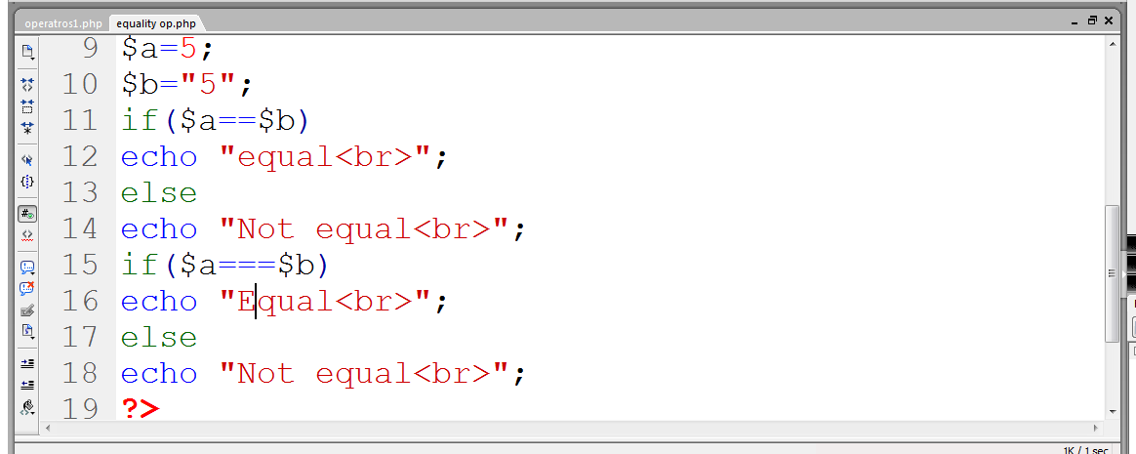

Integer value
String value
Compares only values
Strict comparison
Output

Slide 33
Conditional Statements
if statement:
if(condition)
{
}
if-else statement:
if(condition)
{ }
else
{ }
switch statement:
switch(variable)
{
case option:
action
break;
.
.
}

Slide 34
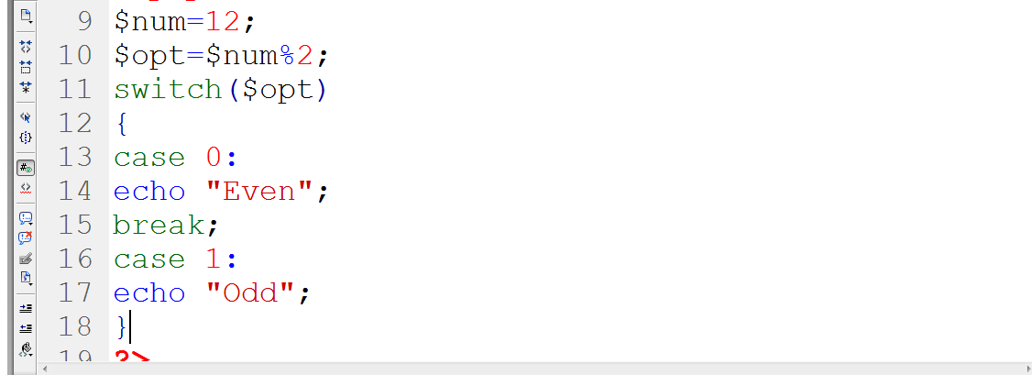

Switch starts
case 0
Case 1
Output

Slide 35
Looping Statements
for loop
while loop
do-while loop
foreach loop

Slide 36
Loops
for loop
for($a=0; $a<10; $a++)
{
statements
}
while loop
while(condition)
{
Statements
Increment/decrement
}
do-while loop
do
{
Statements
Increment/decrement
}
While(condition)
foreach loop
is used to read an entire array

Slide 37
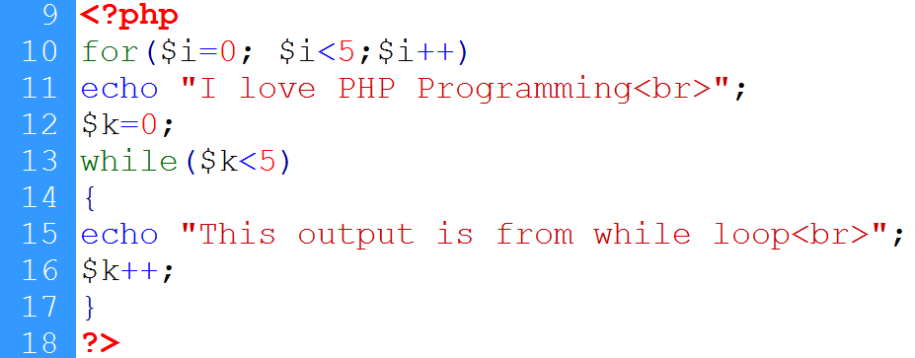
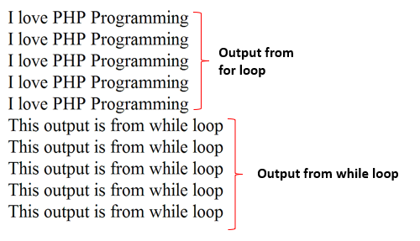
For loop
Output

Slide 38
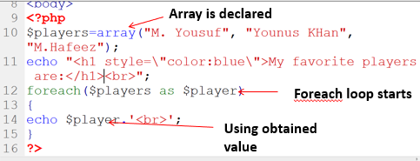
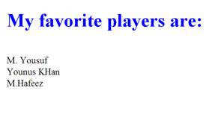
Output

